Slide 1
Coding and Git Practices
Steve Harnett

Slide 2
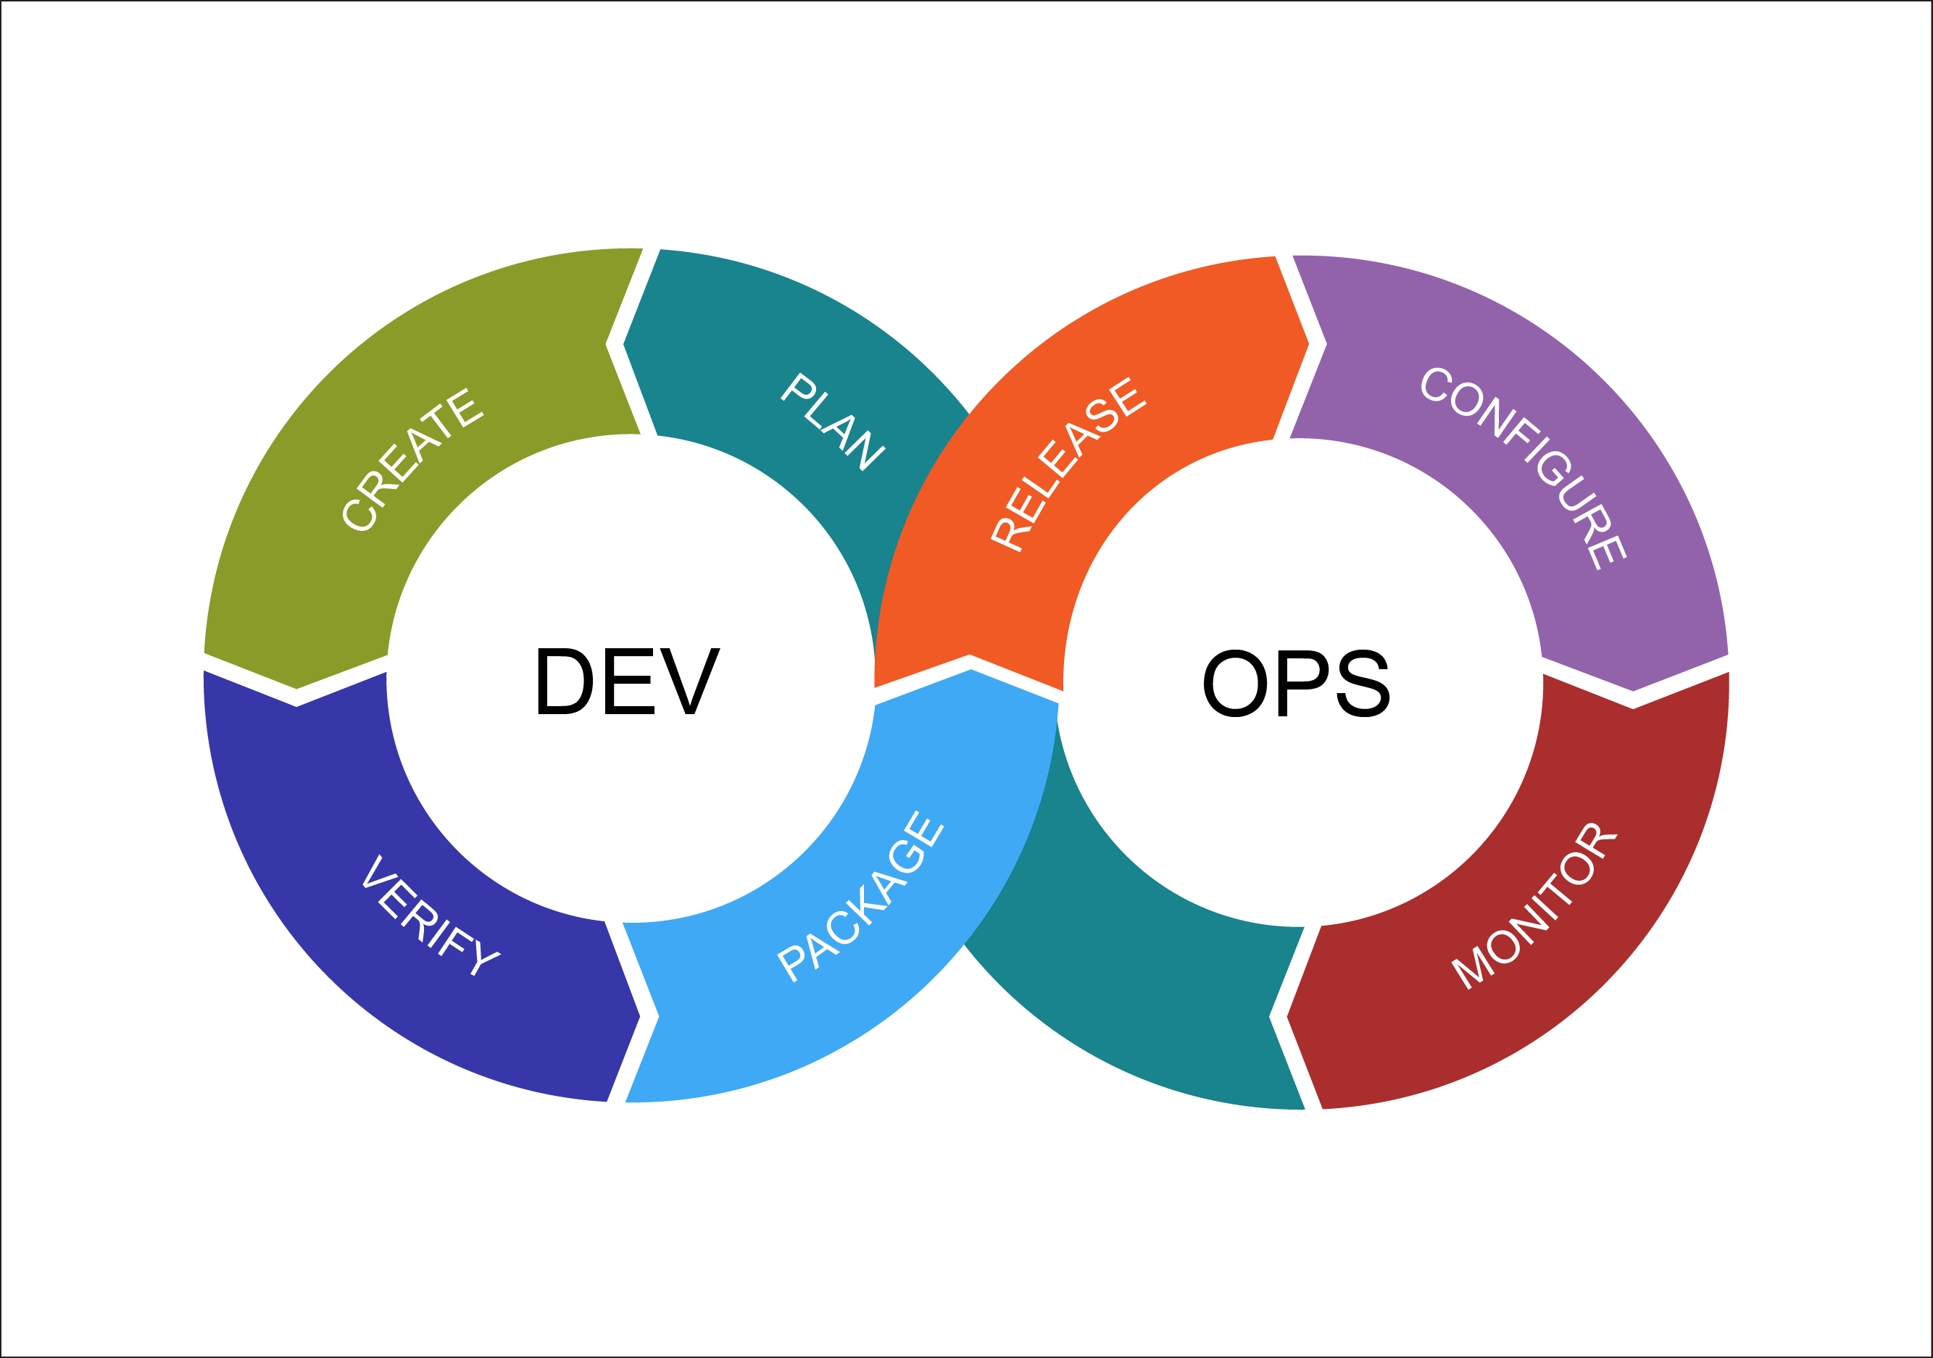
What is the purpose of this slide deck? To explain what practices exist, and why you might use them, not how to execute them (Git and Github documentation already accomplish the latter). Many companies have an entire DevOps team focusing on workflow practices and tools because it’s challenging and affects nearly everything downstream.
https://external-content.duckduckgo.com/iu/?u=https%3A%2F%2Fwww.cabotsolutions.com%2Fpublic%2FDevOps-Cycle.png&f=1&nofb=1

Slide 3

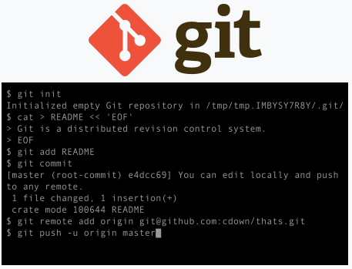
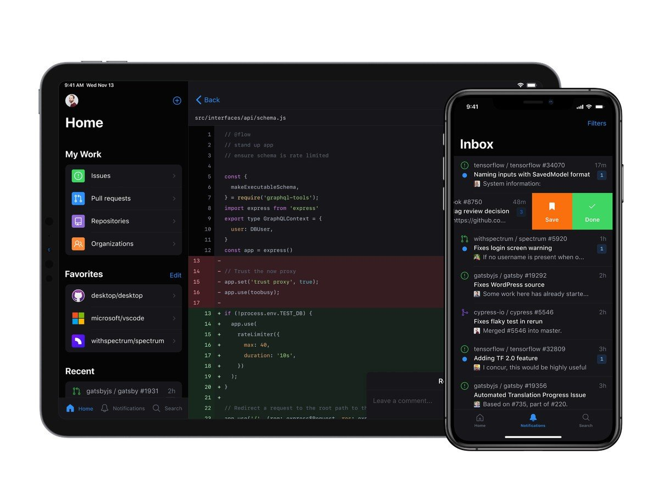
What are Git and Github? Are they the same? Git is a version control system written by Linus Torvalds (the creator of Linux). Github is a popular front end and hosting service for Git repositories.
Notes:
“git” is also a UK slang word for an obtuse person

Slide 4
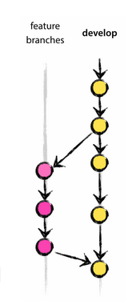
When should I branch? To make experimental changes, whether or not they are to be merged back into the trunk. Why? The health of main should be static. If your change could break main, it should go on a branch off main for development first.
I recommend this branching model for production/industrial use.
Notes:
Some companies play silly games such as making you wear a funny hat if you break main. So please use branches.

Slide 5


When should I commit? When you reach a checkpoint such that code is functional and you may want to revert to this change or cherry-pick this change another branch.
git commit –m will allow the user to pass a helpful commit message as an argument to identify what change is in the commit
https://www.mariowiki.com/Checkpoint_Flag#/media/File:SMG2_Activated_Checkpoint_Flag.png

Slide 6
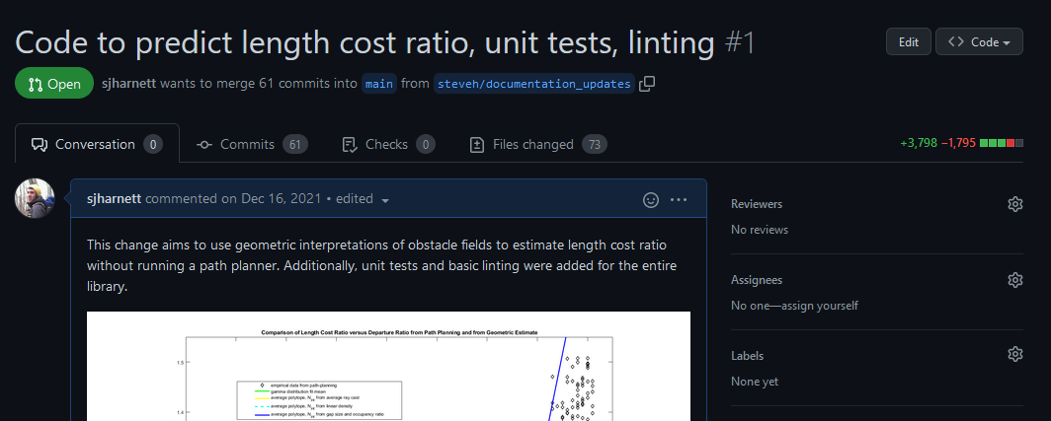
How do I merge back to the trunk? Conventionally on a pull-request (PR) with peer reviews with a squash merge to create a traceability chain. PRs are a great place to document and justify a change.

Slide 7
When do I merge back to the trunk? When you have a body of work large enough to stand on its own (so that reverting this merge doesn’t cause a large dependency break) but when it’s small enough to be manageable for a reviewer. Merges should be squashed for cleanliness of documentation.
Merging
Squash-merging
main
main
steve/really_good_feature
steve/really_good_feature
C1
C1
C2
C2
C3
C3
C4
C4
C3
C3
C5
C5
C4
C4

Slide 8
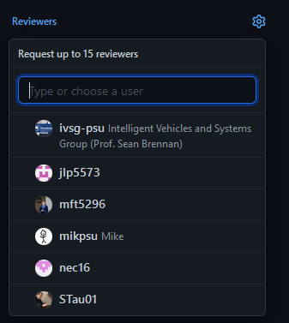
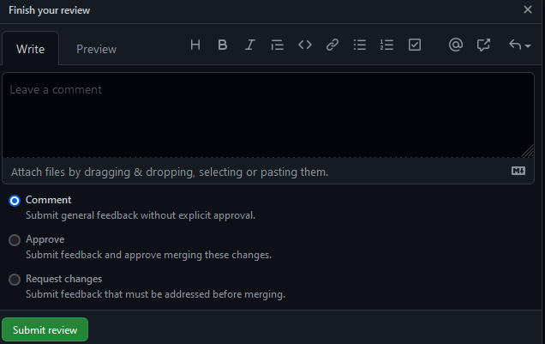
Who should review? What does the reviewer do? Someone familiar enough with the work to understand the function of the code, but not someone who worked on the change. Reviews should be for form and function and comments can be non-blocking or blocking, with respect to merging.

Slide 9

Advanced topics and potential issues…

Slide 10
What is the stash? The stash is where you can temporarily rewind uncommitted changes. Somewhat like reverting for an uncommitted change.
main
steve/really_good_feature
main
steve/really_good_feature
C1
C1
stash
C2
C2
uc3
uc3
git stash pop will restore the stash, while git stash drop will empty it

Slide 11
What is cherry-picking? Merging a specific commit instead of that commit and it’s entire history (recall every commit is is defined not just by the latest change in it, but by all previous changes that lead to that state of the repo.)
main
steve/really_good_feature
main
steve/really_good_feature
C1
C1
C2
C2
C3
git cherry-pick C4
C3
C4
C4
git cherry-pick –x will automatically indicate that C5 originates from C4
C3
C5
C5
C4
C4

Slide 12
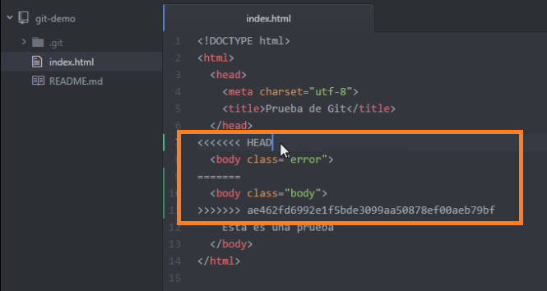
What is a merge conflict? Why am I getting one? When two commits change the same line, Git may not know which change to keep. These can be manually resolved by looking for the “<<<“ strings that flag the conflict. They are also often avoided by rebasing before merging.
https://www.codigonaranja.com/wp-content/uploads/2017/05/merge-conflict-git.png

Slide 13
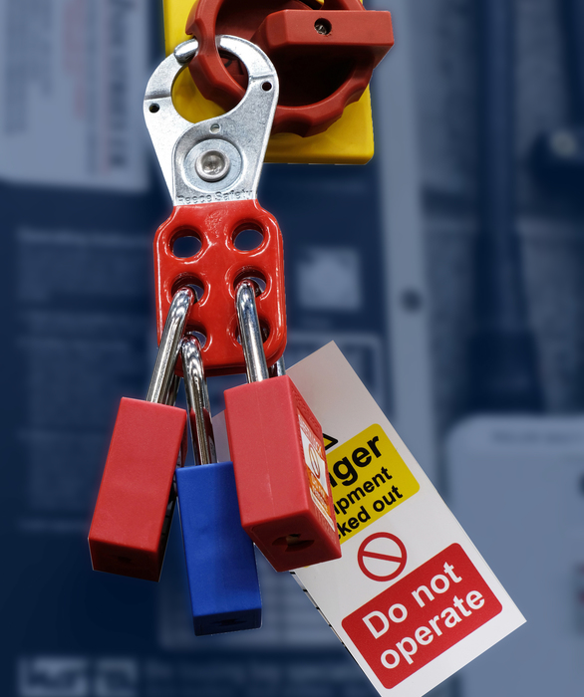
What happens to non-source code files when I commit? Git cannot track changes on compiled or binary files. Merge conflicts need to be manually resolved with care. Git LFS with locking can be employed in production to prevent more than one user from changing the same file at once (similar to a lock-out-tag-out procedure) but this is not trivial.
https://specificationonline.co.uk/articles/2020-03-23/reece-safety-/lockout-tagout-within-construction

Slide 14
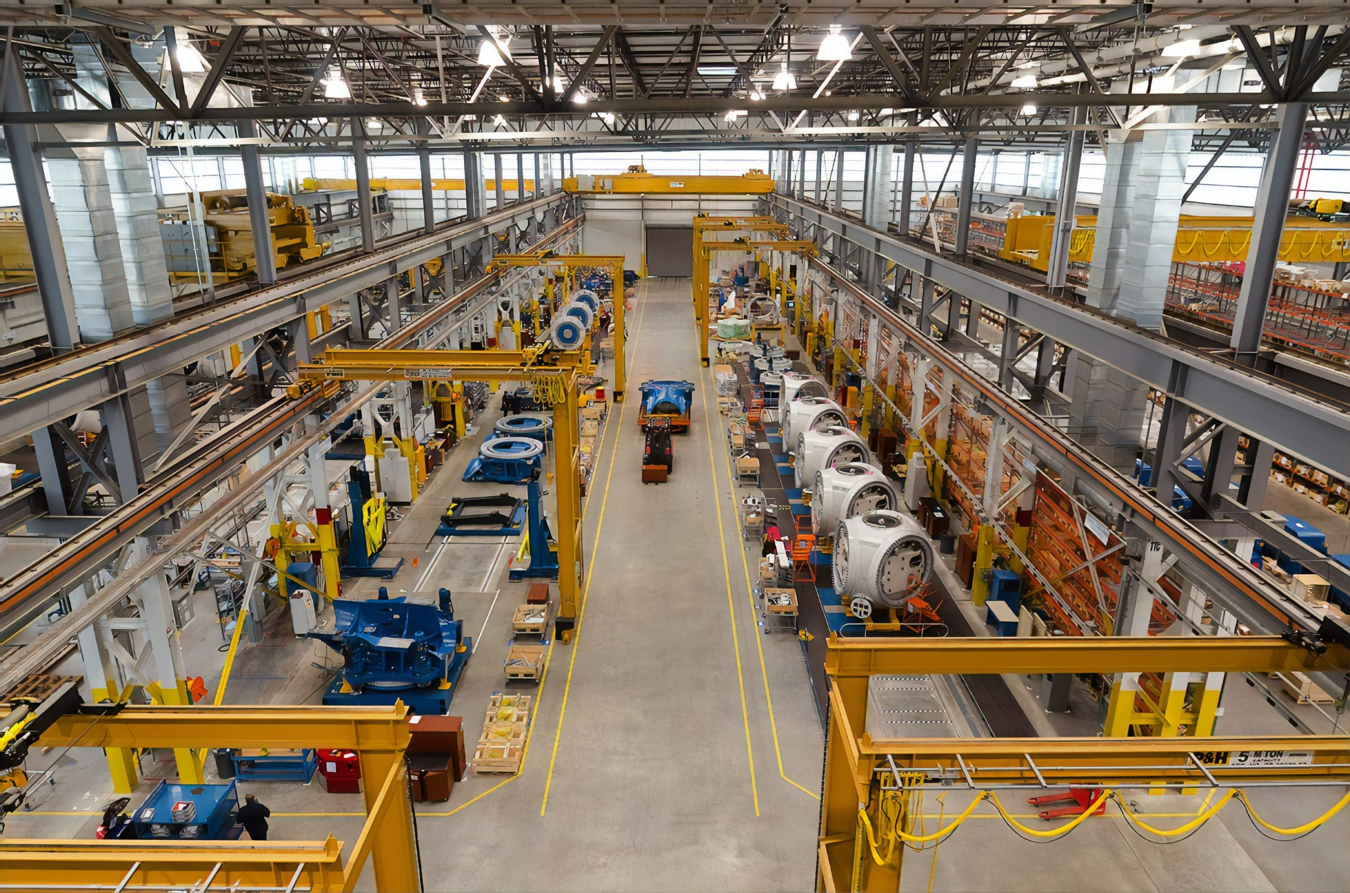
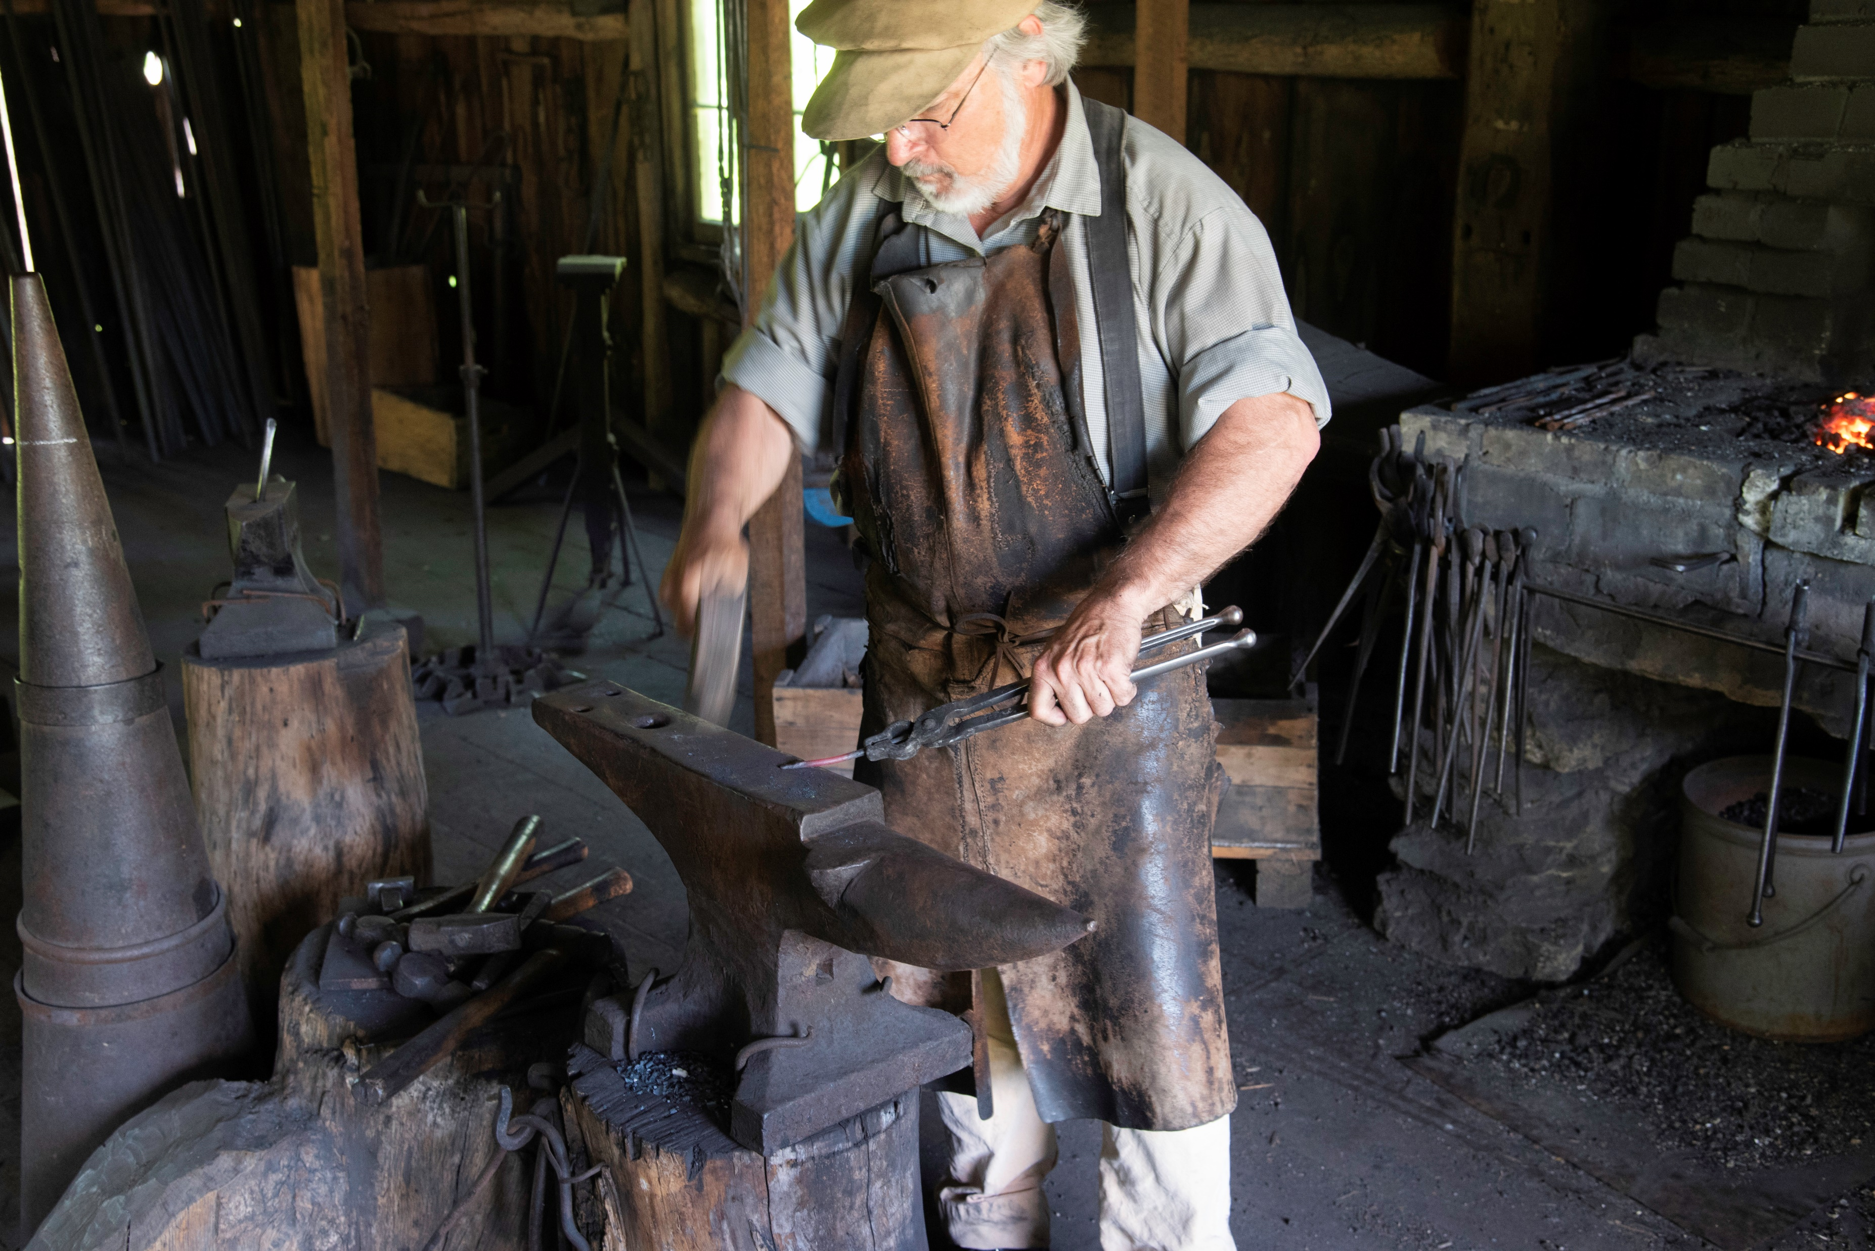
Contrary to the STEM-like perception of programming, source code is more of a craft product than a manufactured one.
Craft less and manufacture more via:
Making use of standard libraries & boiler plate
Using code-gen where possible
Linting according to a style guide
Using an editor with syntax highlighting and autocompletion
VS.
https://www.biggreenswitch.co.uk/wp-content/uploads/2020/06/pazsrqf3xuq-scaled.jpg
https://www.goodfreephotos.com/albums/united-states/wisconsin/wade-house/blacksmith-working-on-the-anvil.jpg

